Slide 1


EPICS @ BUTLER x Shalom Health Care Center
Reece Parks, Matt Fleschner, Rachel Maier, Hallie Nuccio, Miles Mann

Slide 2
TABLE OF CONTENTS
01
02
03
04
05
06
PROJECT GOALS
TEAM INTRODUCTION
CLIENT DESCRIPTION
OUR ACCOMPLISHMENTS
FUTURE WORK
OUR EXPERIENCE

Slide 3
01
TEAM INTRODUCTION

Slide 4
TEAM MEMBERS + ROLES
Team Leader → REECE PARKS
Front-End Developer → RACHEL MAIER
Back-End Developer → MATT FLESCHNER
Quality Assurance Tester → MILES MANN
Client Liaison/Documentation → Hallie Nuccio

Slide 5
02
CLIENT DESCRIPTION

Slide 6
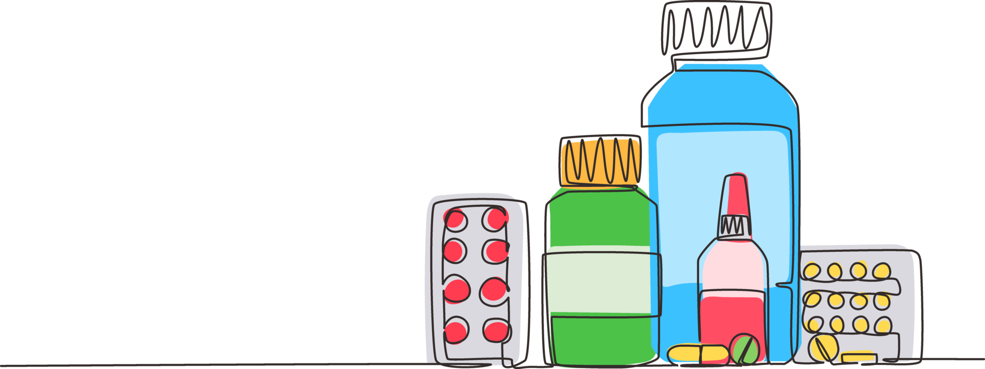
What is Shalom Health Center?
Medical home with two different locations in the greater Indianapolis area.
Its Mission: provide quality health care that is patient-centered, affordable, and accessible for all in the community while remaining compassionate, inclusive, and professional.
Number of Current Patients: 13,350
Services Provided: Primary Care, Telemedicine, Behavioral Health, Health Promotion, HIV & PrEP Navigation, School Based Clinics

Slide 7
03
PROJECT GOALS

Slide 8
Project Description
Shalom Annual Health Fair: allows people from the surrounding communities to access/receive care that they may not normally be able to get.
Location: their main campus on Lafayette Road
Potential Obstacles to Consider:
1) Language Barrier
2) Outside Glare on Computer Screen
3) Ways to Set Up Questions on Digitized Form for Quick Completion
4) Ability for Vendors to Access Information (HIPAA Compliance)
Notes:
(the registration process will take place outside)

Slide 9
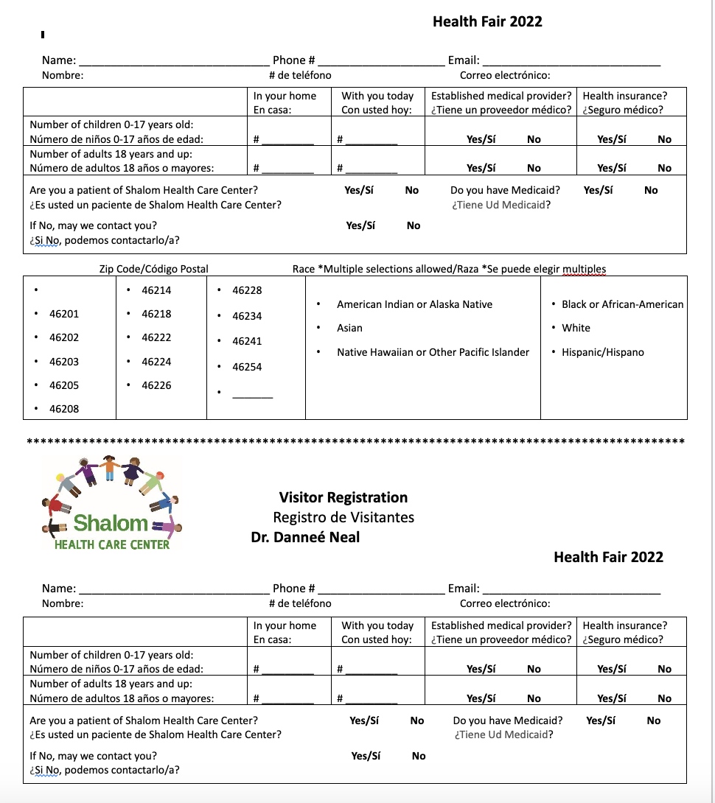
Project Goals
Main Goal: Digitization of the Health Fair Registration Form
Front–End Goal: Registration Form Design
Back-End Goal: Database Creation

Slide 10
04
OUR ACCOMPLISHMENTS

Slide 11
The Frontend Deliverables
Visual:
Pages:
Functions:
Language Buttons
Registration Page Input Fields
Additional Person(s) adaptive Registration
Home Page Navigation Buttons
Home Page
Patient Page
Construction Page
Admin Page (WIP)
Vendor Page (WIP)
Website Navigation
Submitting Form
Language Toggle
Auto establishing additional persons data fields

Slide 12

Frontend Demo

Slide 13
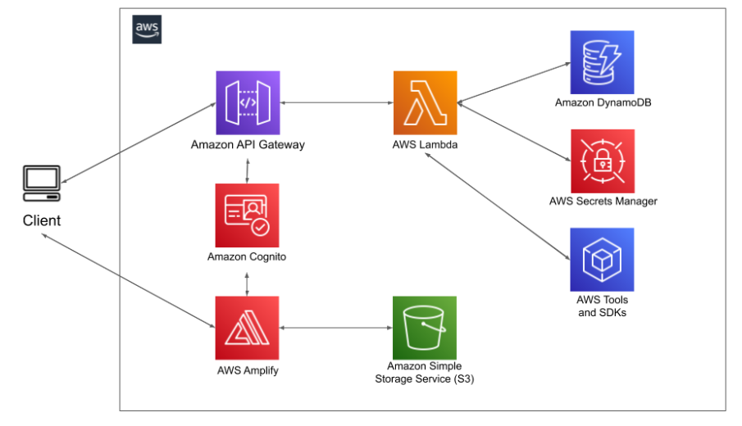
The Backend Deliverables
Used the following tools:

Slide 14
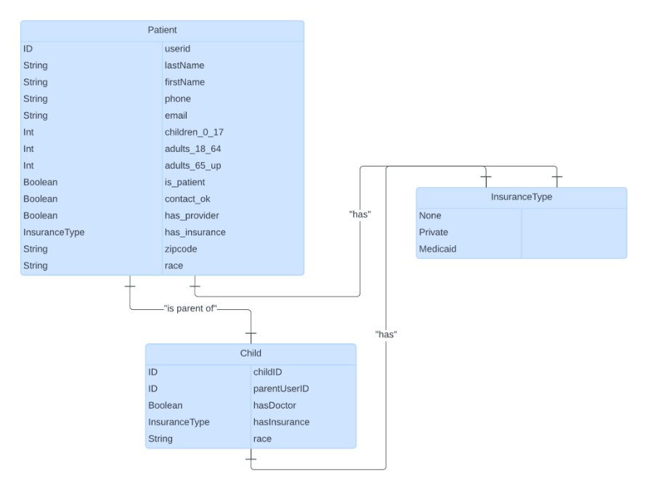
Backend Deliverables (Continued)
Worked off what the previous semester's team formed
Two Tables:
Patient
Child
Linked by userid and parentUserID
Pulled directly from form and stored in the tables accordingly

Slide 15
05
FUTURE WORK

Slide 16
The Next Steps
Admin & Vendor Functionality
Ability to query and pull key health fair statistics
Encryption/Decryption
QR Code Generation

Slide 17
06
OUR EXPERIENCE

Slide 18
What We Learned
Our Challenges:
Connecting the Back end to the Front end
Learning React JS/TS
Handling Errors
What We Learned:
Keep communication with a client in a professional environment
Set up a secure AWS Database
Create and design a React Web Application

Slide 19
THANK YOU!
QUESTIONS?

